Slide 1
HCI AR PROJECT
https://github.com/PaleCosmos/HCI_AR_PROJECT
201735829 박상현

Slide 2


Marker

Slide 3
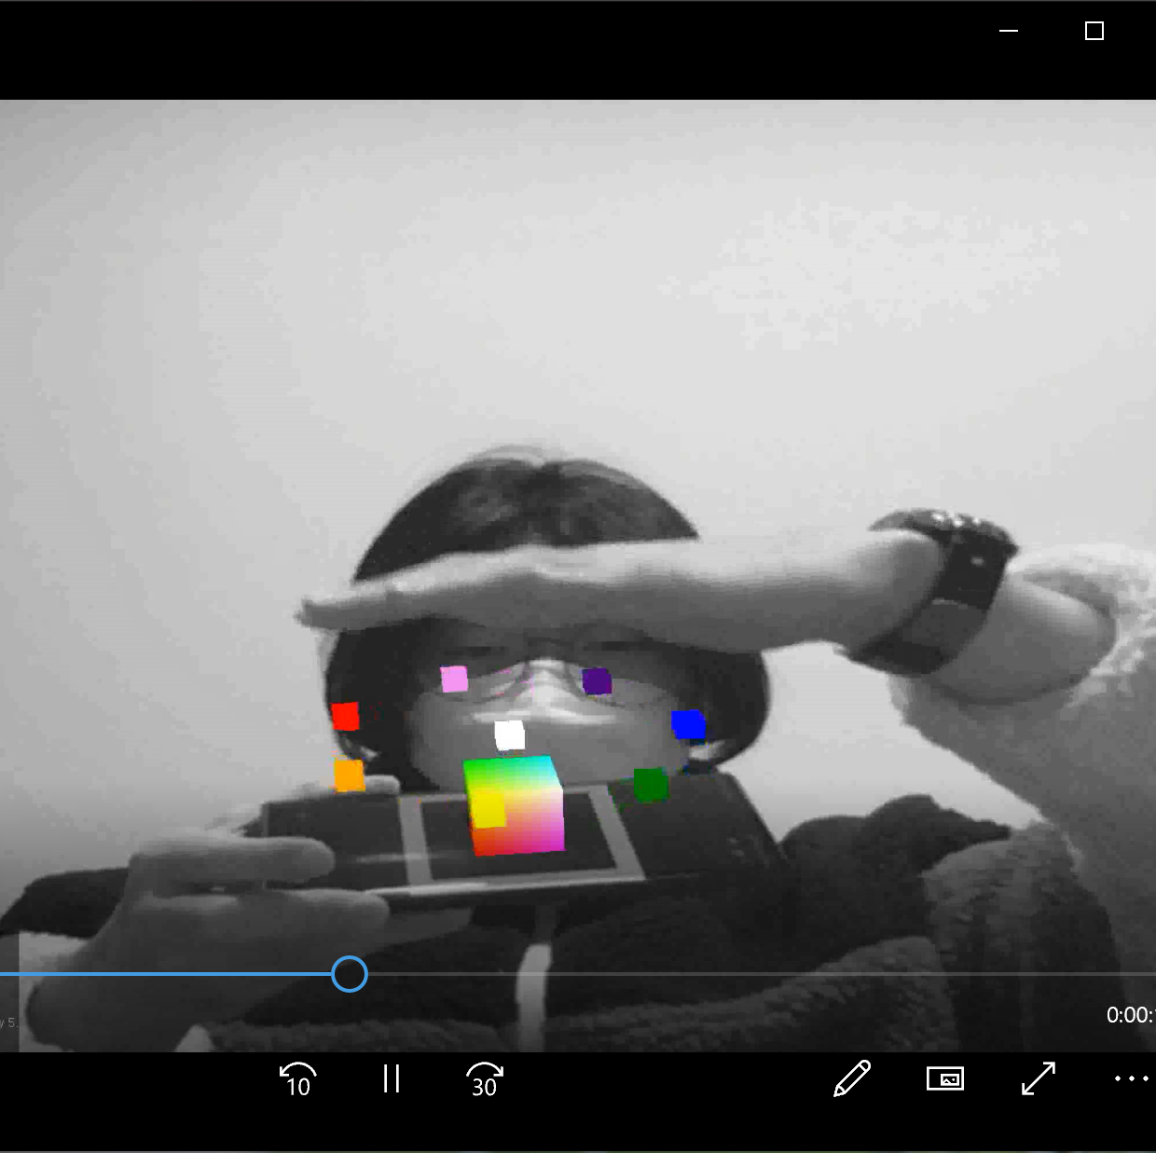
Object shape
In the original code, I made a simple cube.
But I made several colorful cubes.

Slide 4
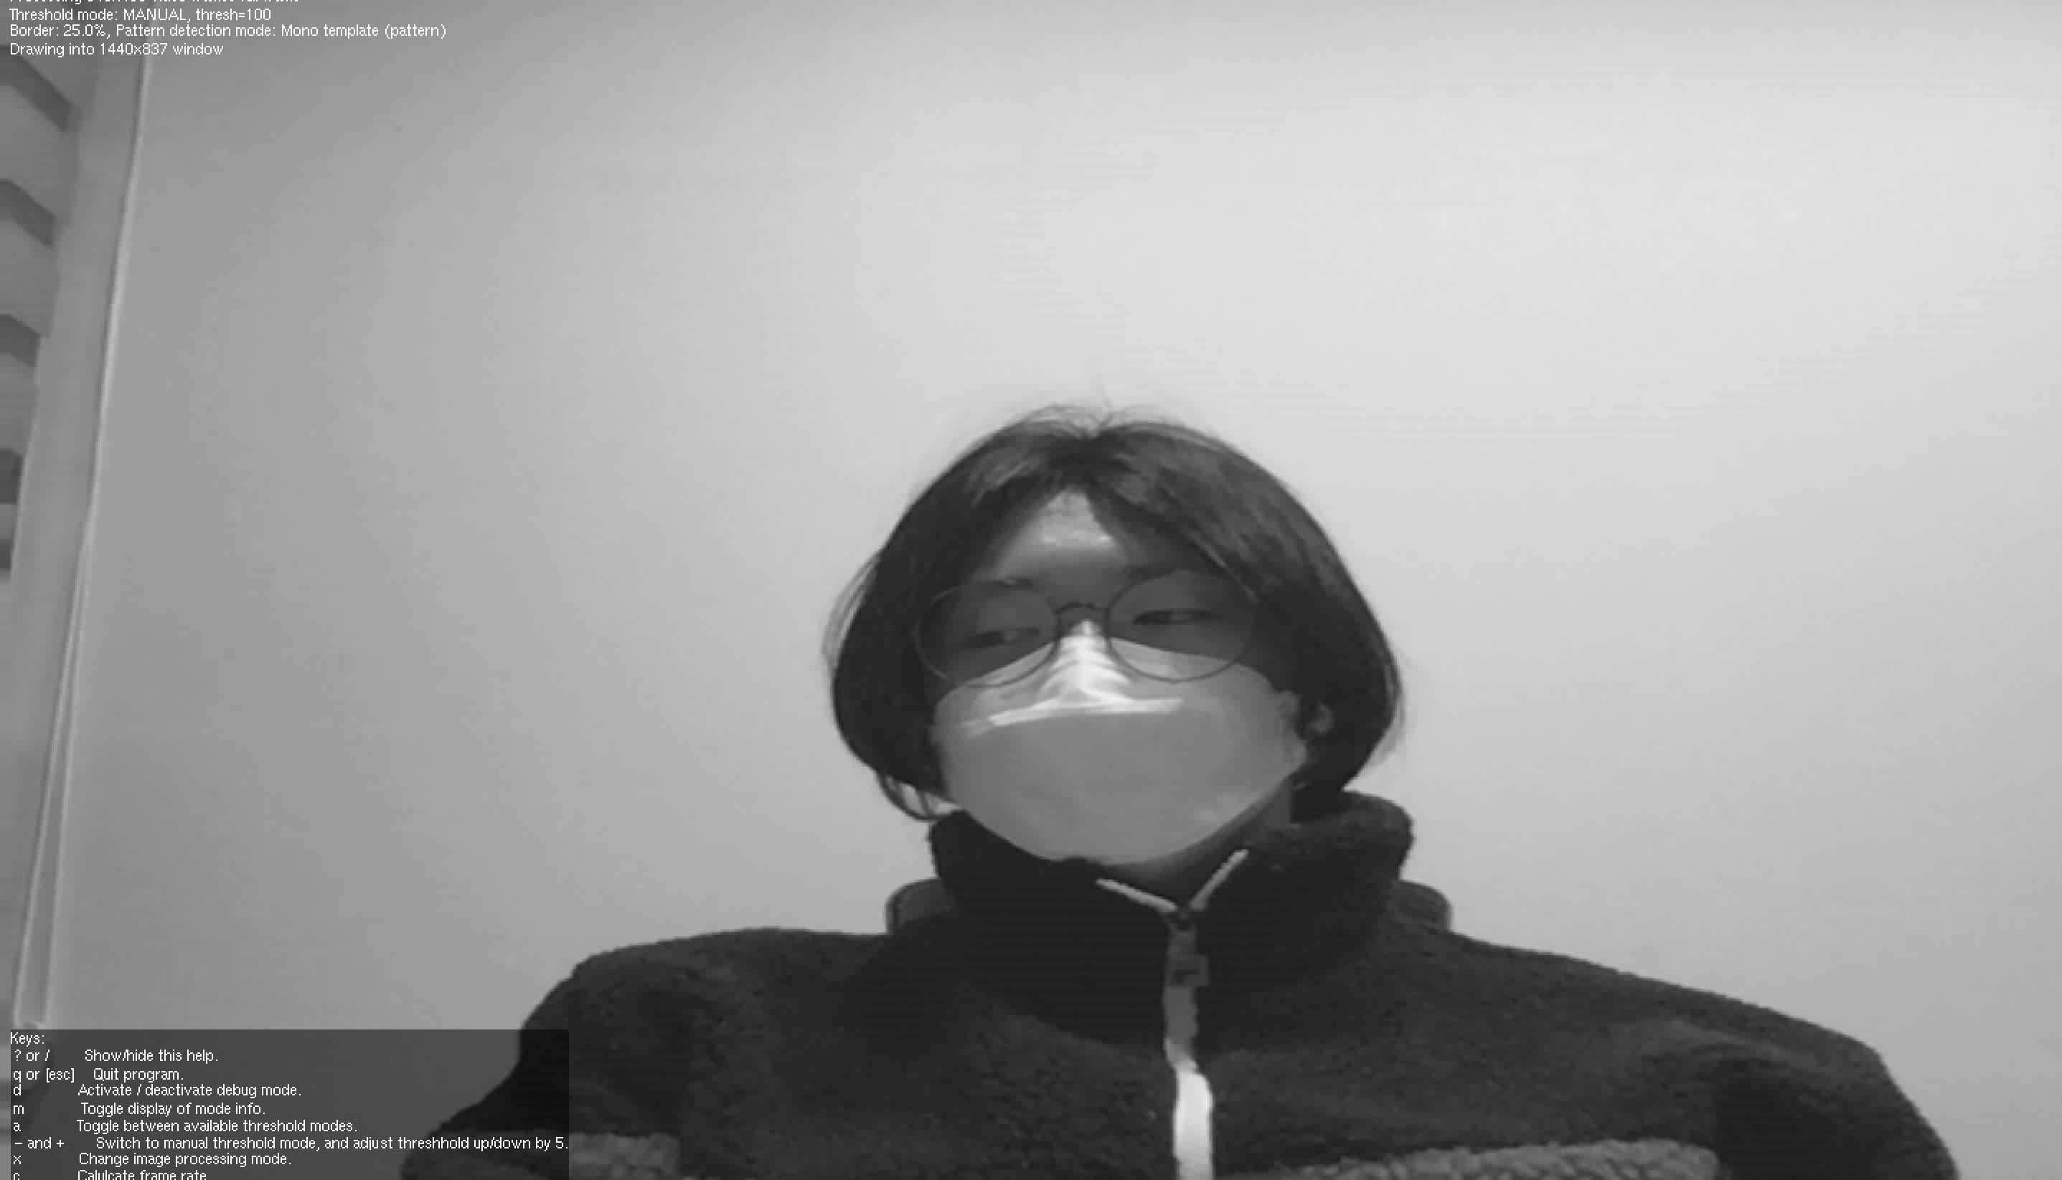
Animation (DEMO)

Slide 5
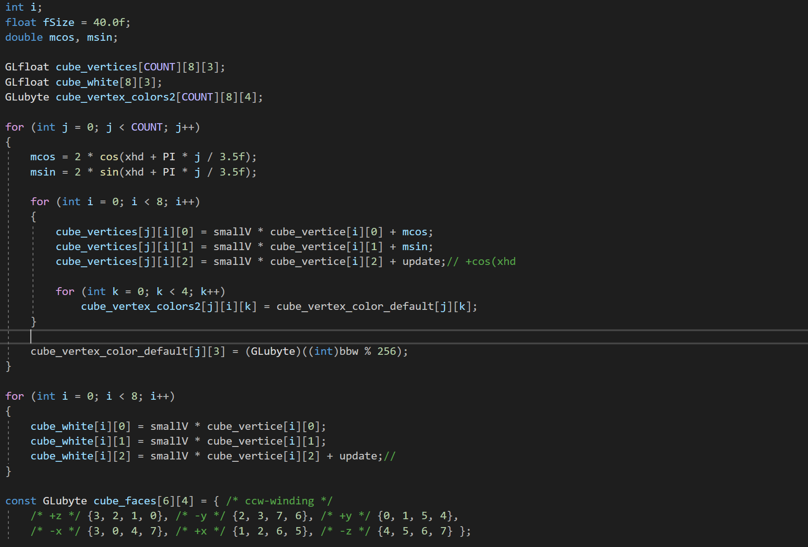
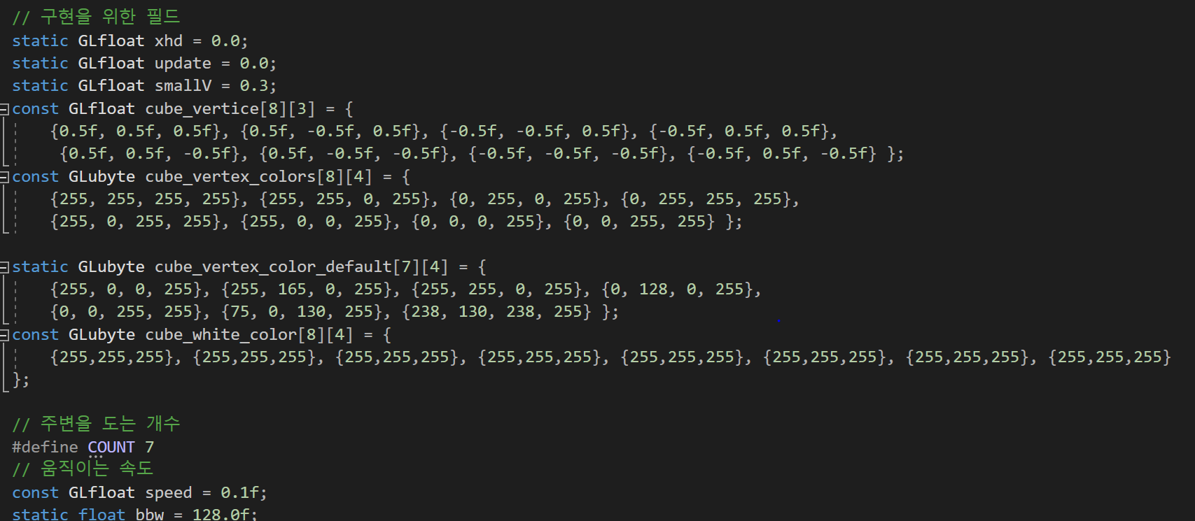
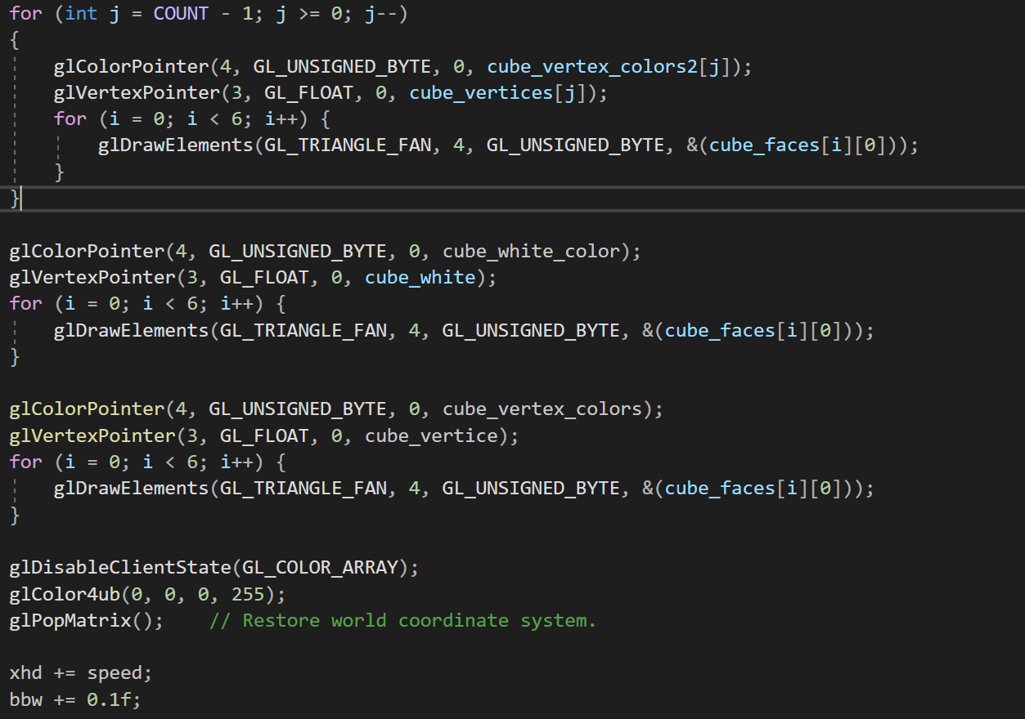
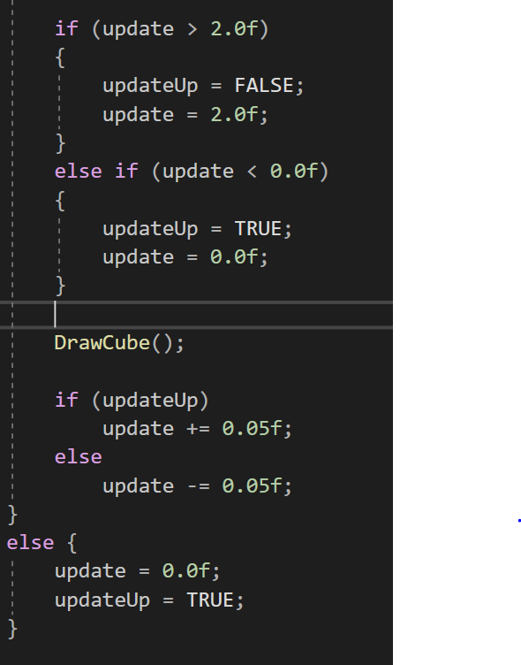
CODe
Vertices and Colors for object implementation
Preprocessing for object rotation and pendulum motion
Setting flags and speed
for object pendulum motion
Puting the vertices of the object in the buffer and increasing
the rotation angle and change the height at the same time

